Slide 1




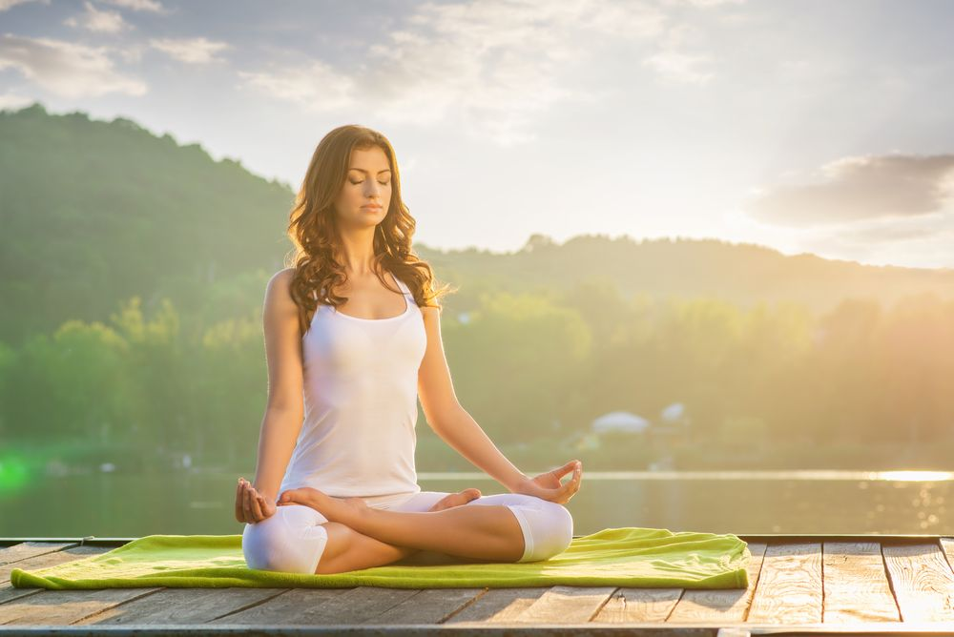
UNIVERSITY COLLEGE FOR WOMEN, KOTI
International Yoga Day
(1
REPORT
15th -21st June 2020

Slide 2
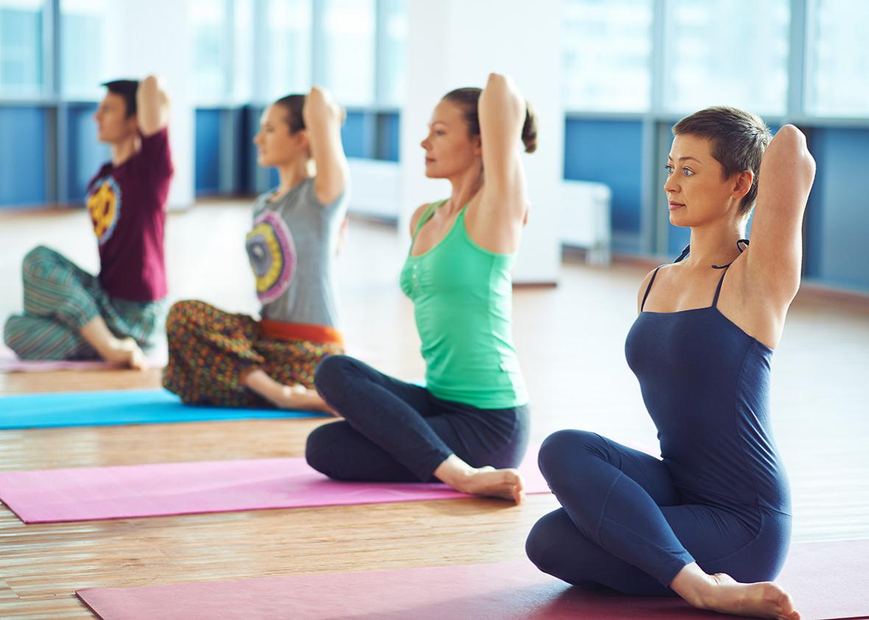
YOGA
Yoga is a group of physical, mental, and spiritual practices or disciplines which originated in ancient India. The purpose of yoga is to build strength, awareness and harmony in both the mind and body.
Physical benefits
increased flexibility
increased muscle strength and tone
improved respiration, energy and vitality
maintaining a balanced metabolism
weight reduction
Mental benefits
Stress can reveal itself in many ways, including back or neck pain, sleeping problems, headaches, drug abuse, and an inability to concentrate. Yoga can be very effective in developing coping skills and reaching a more positive outlook on life.

Slide 3

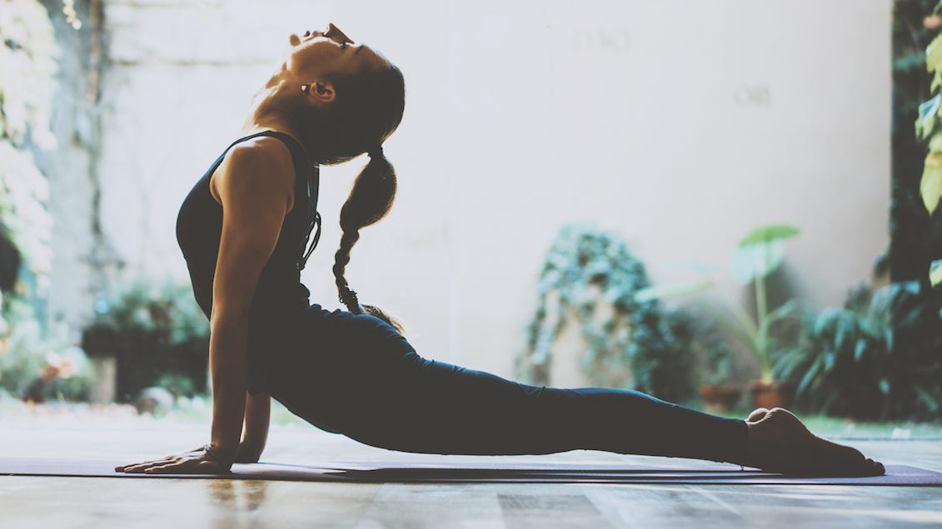

ACTIVITIES DONE BY
NSS VOLUNTEERS
Yoga Week Challenge

Slide 4
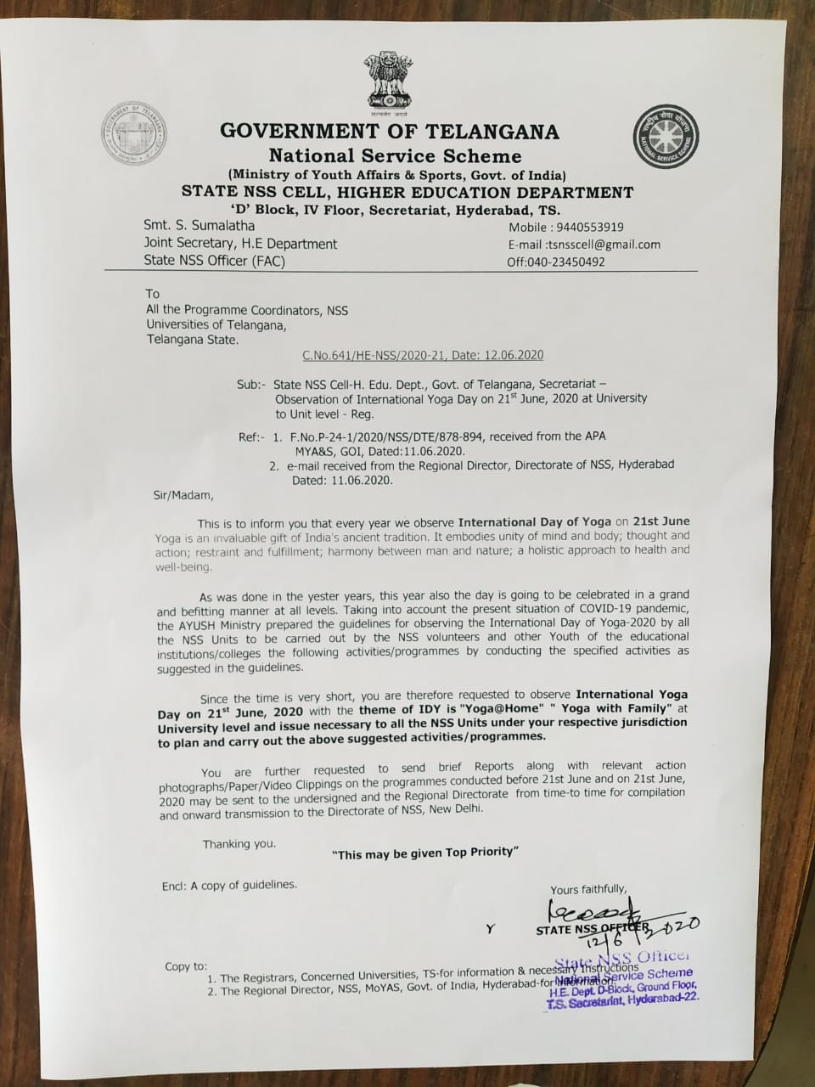
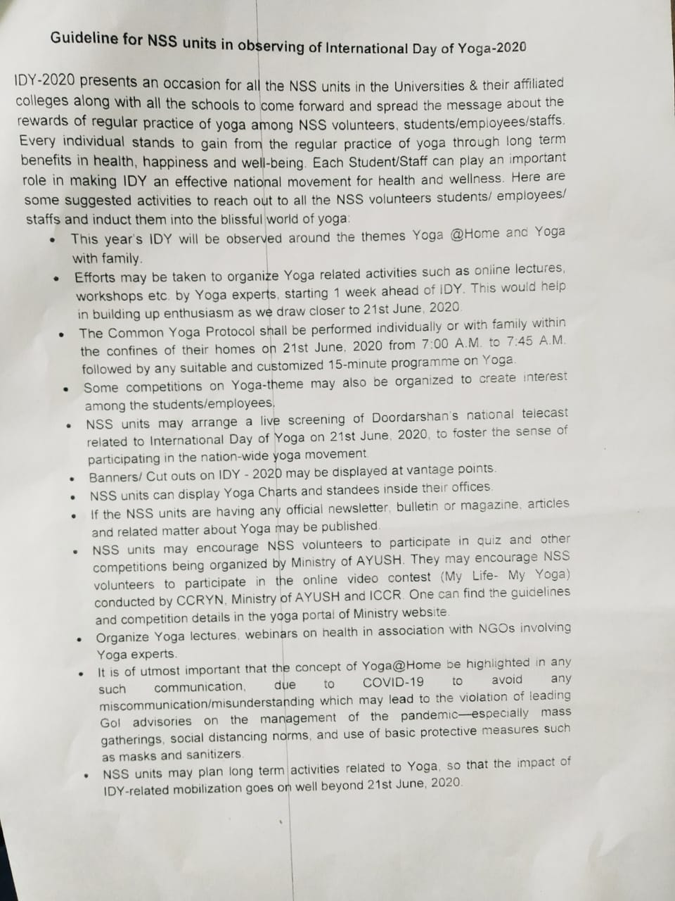
As Per The Protocol Given By NSS Cell, The following Activities of UCW Has been planned.

Slide 5
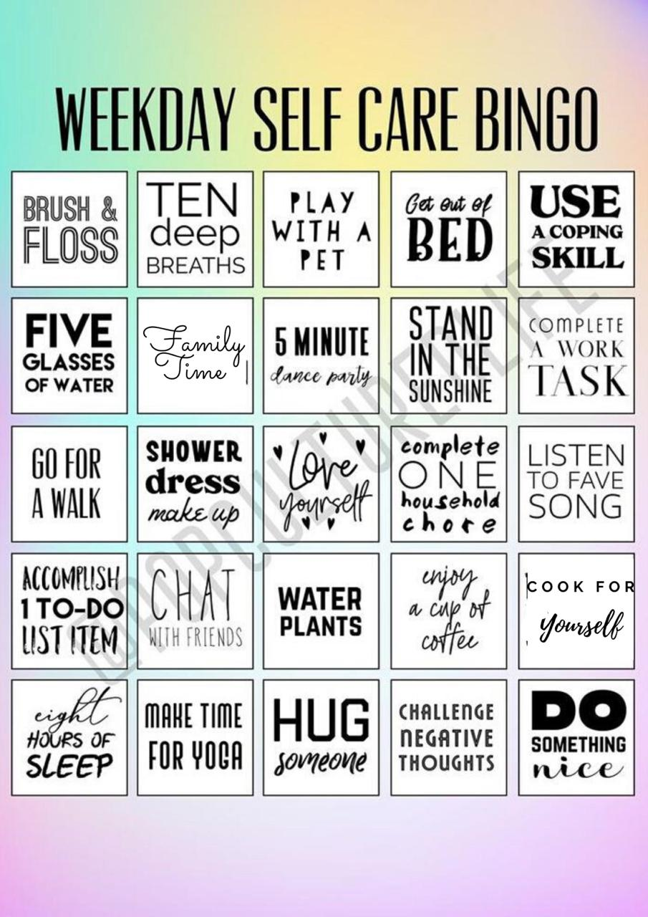
ACTIVITY 1
# Everyday Challenge
Challenge we have given ourselves to make Habituated with the activities given in the picture. Daily we have given a emojis to mark the things we did. From 15-06-2020 to 20-06-2020 i.e 6
days we challenged ourselves.
Response of the activity is so good that most of the volunteers has learned to make them as habit.

Slide 6

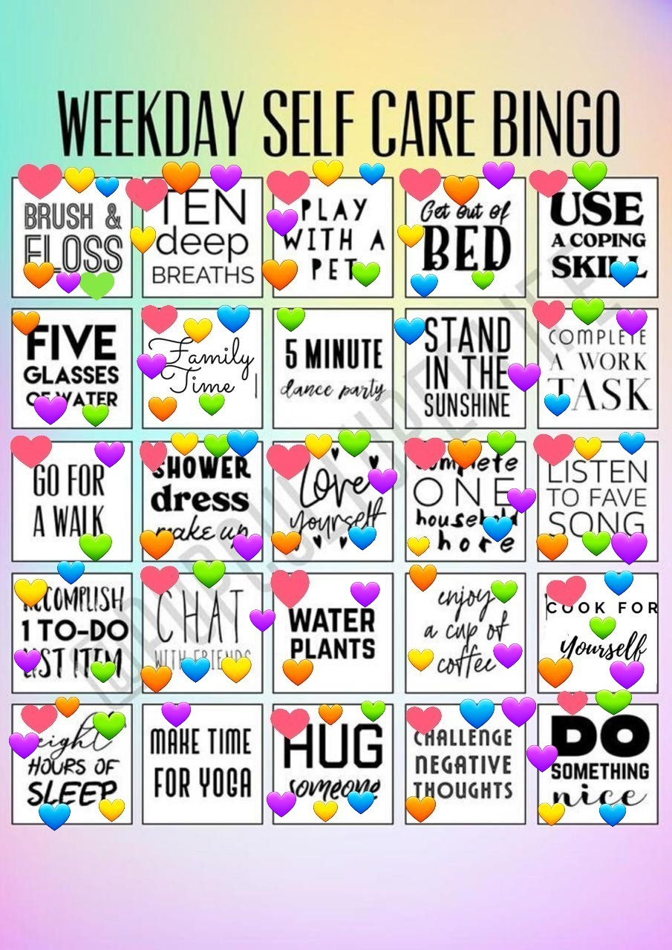
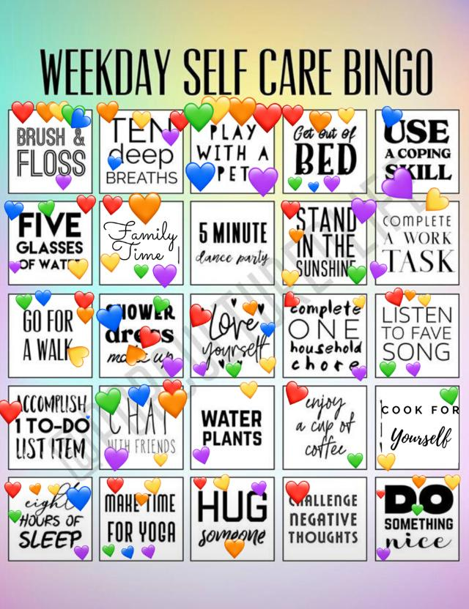
SAMPLES OF THE EDITED PICS ABOUT THE ACTIVITY

Slide 7

ACTIVITY 2
# Positivity Within Me
Yoga mostly promotes Positivity within us. This activity has been done on 15-06-2020 and 16-06-2020. We wanted to get those positive vibes out with little touch of creativity. We have asked the volunteers to figure out the Things in which they feel positive. And then they have to make those things in a COLLAGE. In this way we can remind them their positivity.

Slide 8

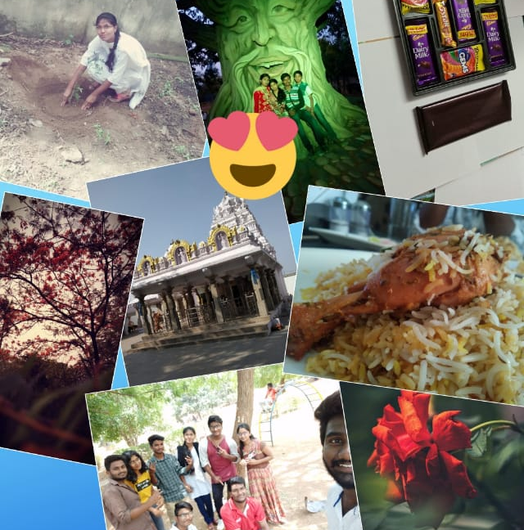
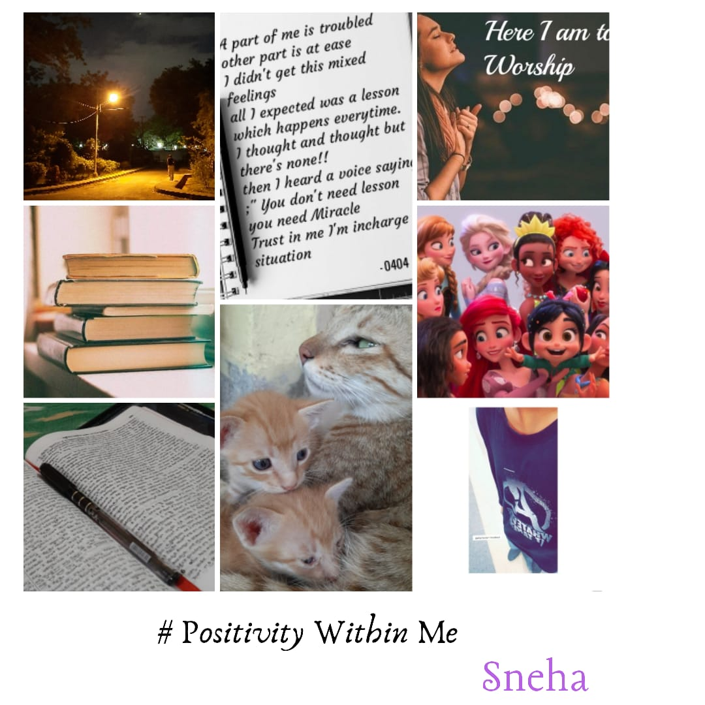
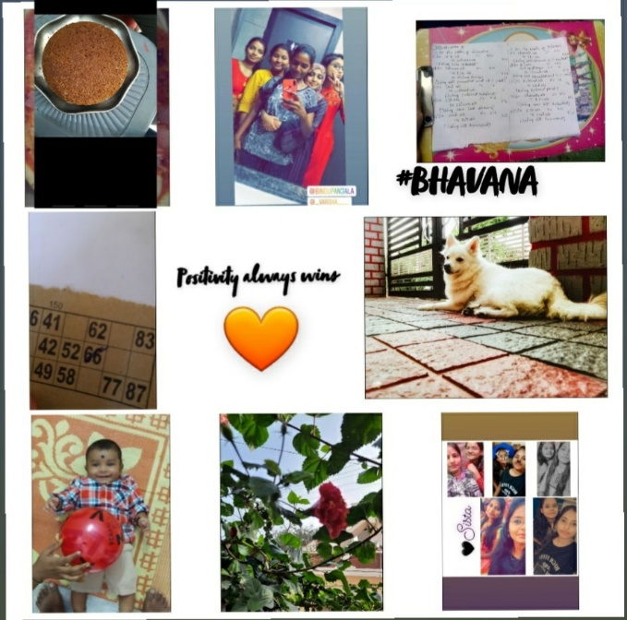

FEW COLLAGES DONE BY VOLUNTEERS

Slide 9
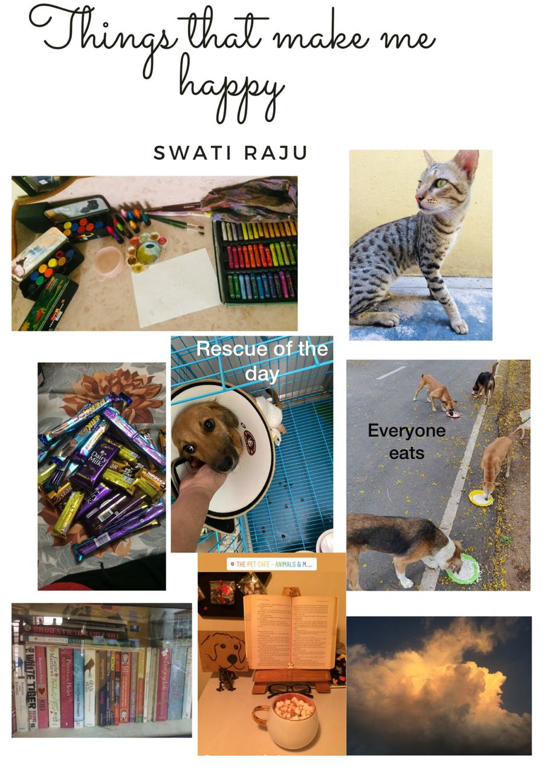


Slide 10

ACTIVITY 3
Yoga @ Family
During Lockdown, everyone is taking time to spend with their families. We want to create a happy and healthy environment in it. So the volunteers were asked to take a picture while doing and teaching their family about Yoga. Families have activity participated in it and learnt about Yoga. On 17-06-2020 and 18-06-2020 this activity has been done.

Slide 11
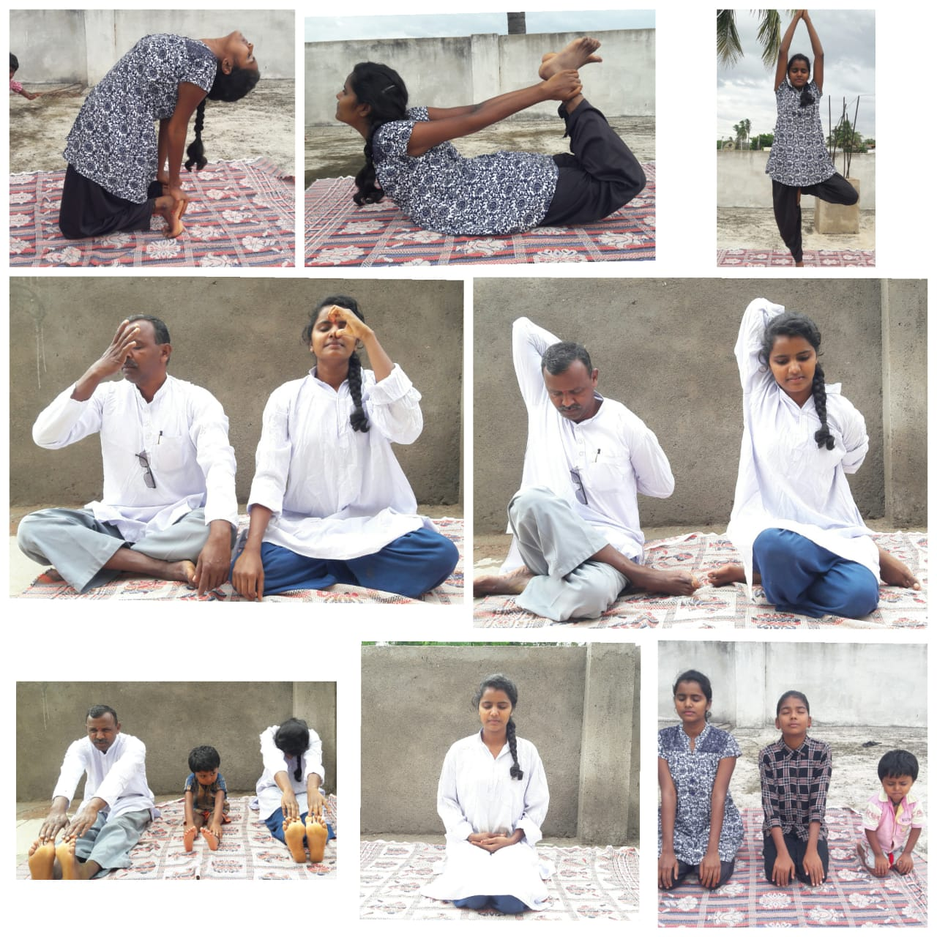
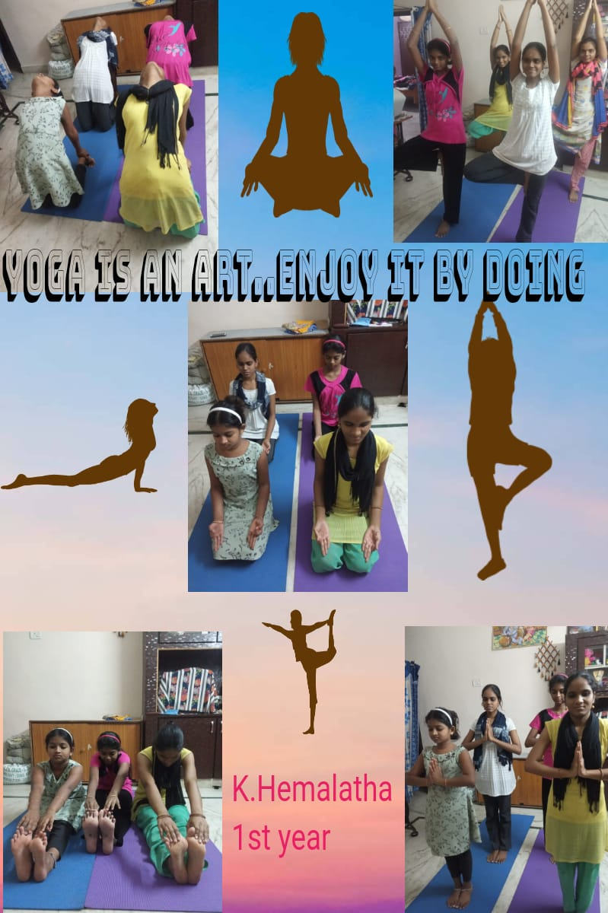
OUR VOLUNTEERS DHARANI AND HEMALATHA WITH THEIR FAMILY AND SIBILINGS

Slide 12
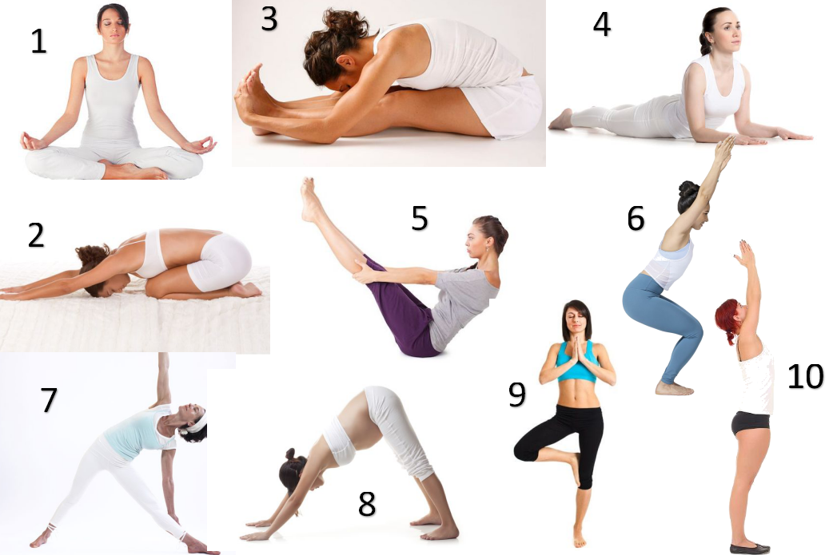
ACTIVITY 4
# My Yoga Asanas
This activity was done on 19-06-2020 and 20-06-2020. These all activities are done cause of Yoga. To make volunteers know about it. We’ve asked volunteers to choose any 5 of their favourite asanas and make them into a video giving the benefit of each asana.

Slide 13
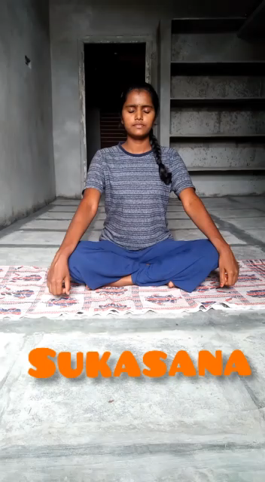
ONE OF THE VIDEOS VOLUNTEERS HAVE DONE.
THIS VIDEO DONE BY K. SRIBHANU

Slide 14

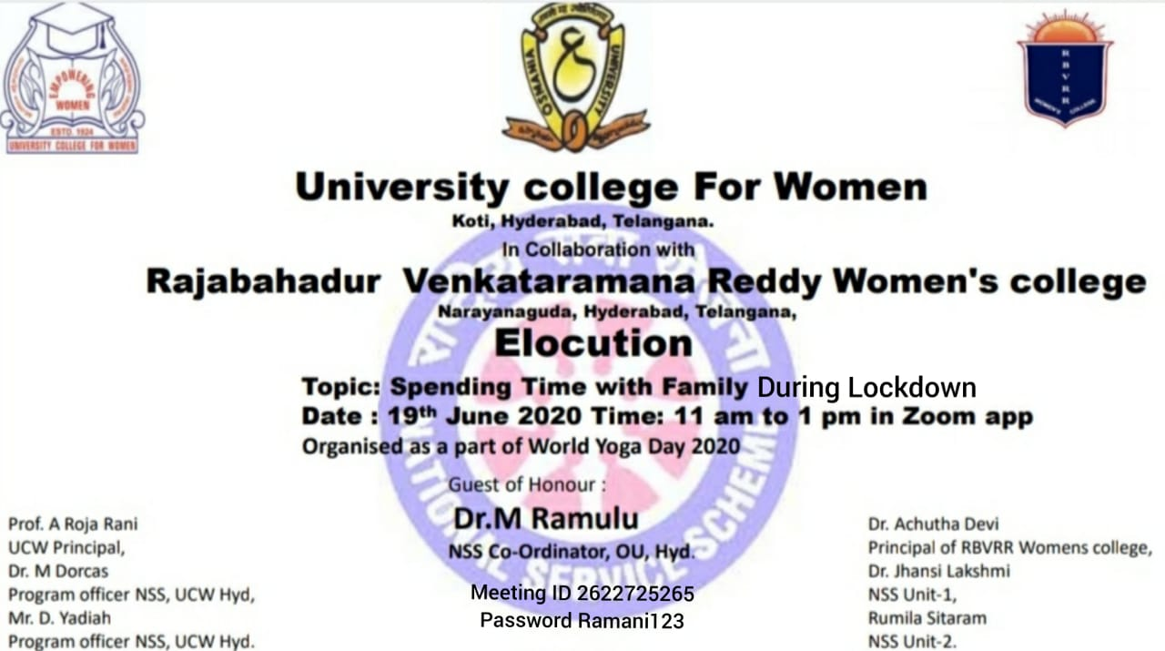
ACTIVITY 5
In Collaboration with RAJABAHADUR VENKATARAMA REDDY WOMEN’S COLLEGE, Elocution competition has been done on 19-06-2020 on the topic Spending Time With Family During Lockdown. Not only the volunteers of UCW and RBVRR many other volunteers from different streams and colleges has joined.
Session was conducted by UCW volunteers. There has been many appreciations for the stand both UCW and RBVRR colleges has taken.

Slide 15

ACTIVITY 6
On 20-06-2020, QUIZ and E- Poster competition is been held. The topic for E- poster competition is Role of Yoga In Handling Corona Pandemic.
Session was conducted by RBVRR Volunteers. In this even students of Grade 8th and 10th has taken part. We are very proud to announce it.

Slide 16

ACTIVITY 7
To end the whole Yoga Week Challenge, We have organised a webinar on 21-06-2020 i.e. International Yoga Day. On this day we have invited Ms. Thanvi Sree Goud as a Yoga session teacher who is also a NSS Volunteer. We have decided this day for the announcement of all the winners who have actively participated and proved their talents. As Guest of Honour, Dr. M. Ramulu is been invited. With this the whole Yoga week has been completed.

Slide 17
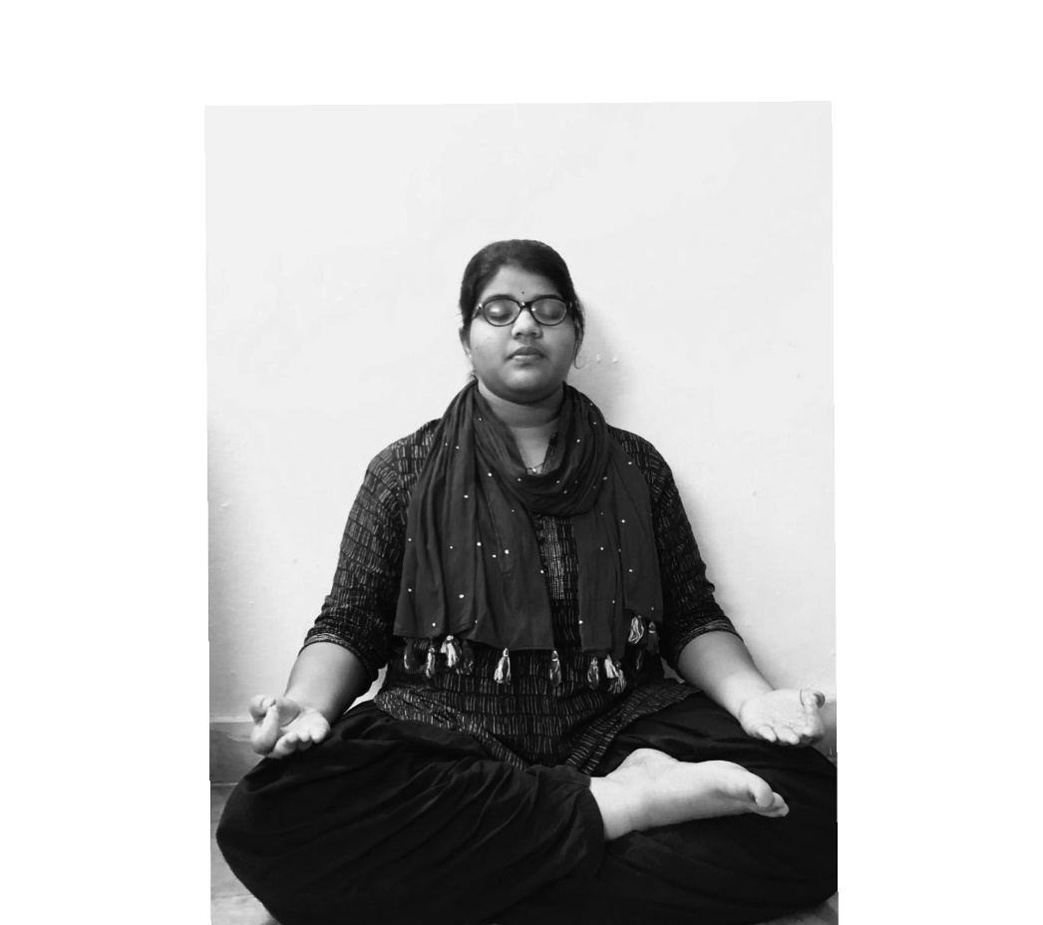
YOGA SESSION BY
Ms. THANVI SREE
B.A. 2nd year
Trained Teacher in Yoga

Slide 18
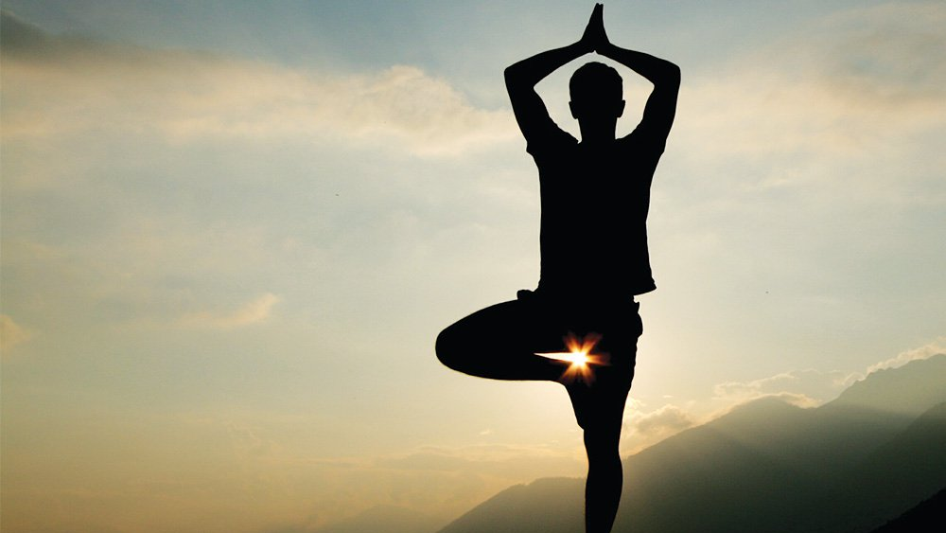
THANK YOU
HAPPY YOGA DAY

